Slide 1
Thermal Camera Project
Jacob Stafford, Bright Lu, Steven Shreve, Fuli Wang

Slide 2
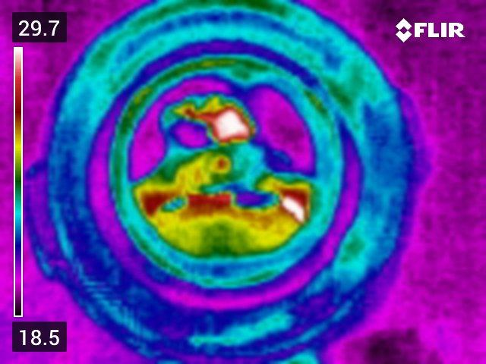

Slide 3
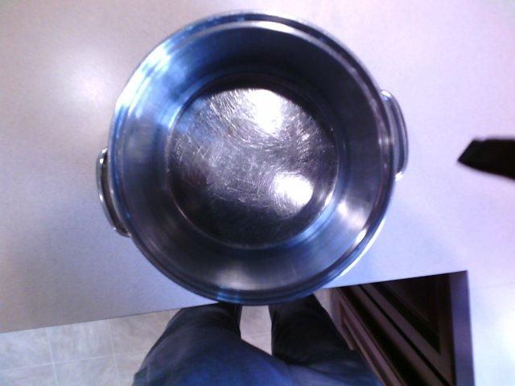

Slide 4
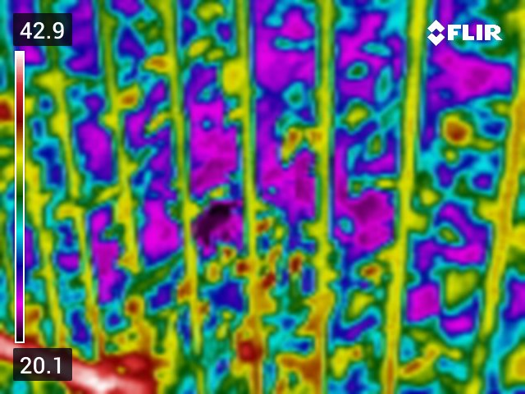
What can be done about this?
Thermal camera that can convert a thermal image to RGB
Deep learning enables conversion from thermal to RGB
Develop software package that uses deep learning to convert thermal to RGB

Slide 5
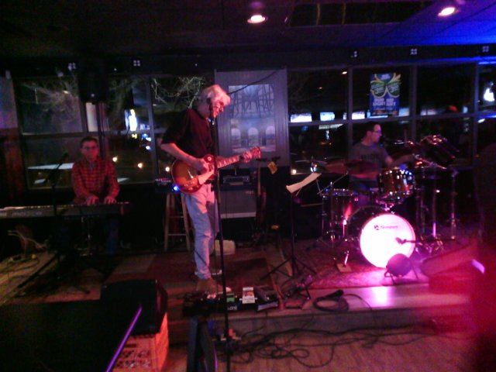
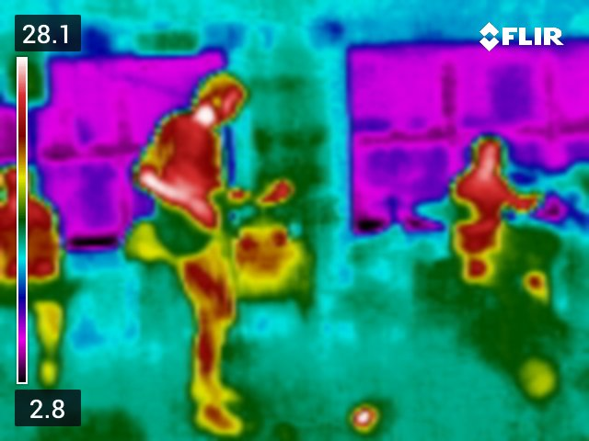
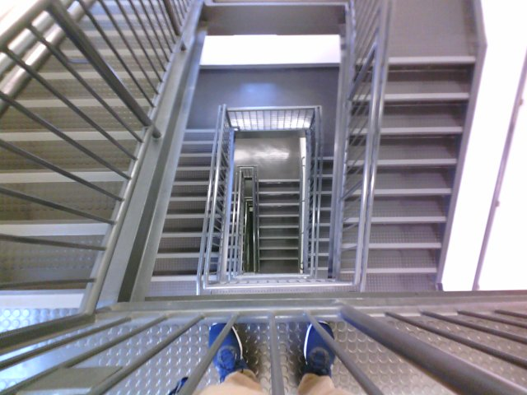
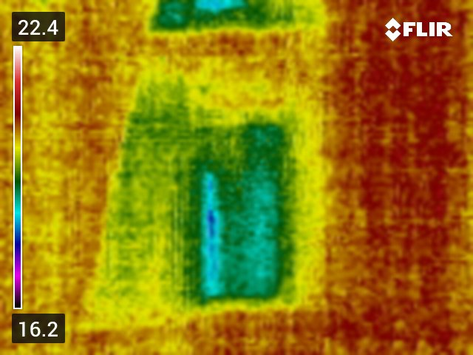
Data acquisition
We took a large amount (over 800 sets) pictures to be used as data to train/test our algorithm
Took sets of thermal and RGB images

Slide 6
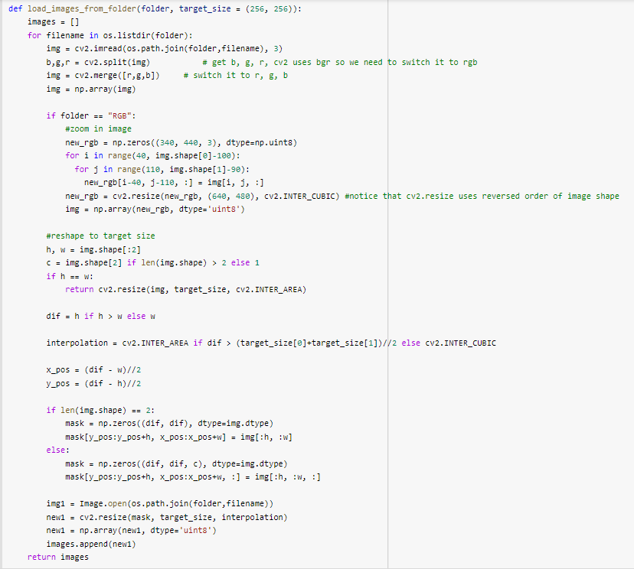
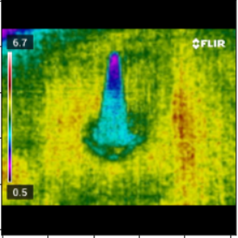
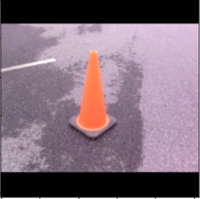
Pre-Algorithm Processing
Load data from Google drive
Shrink the RGB to match the size of Thermal
Resize images to all be 256x256

Slide 7
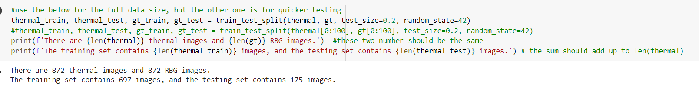
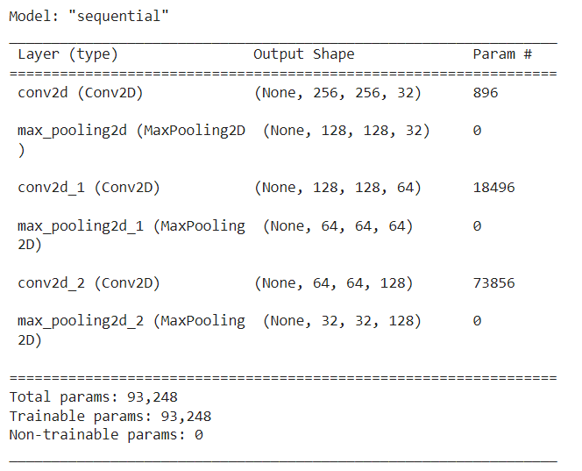
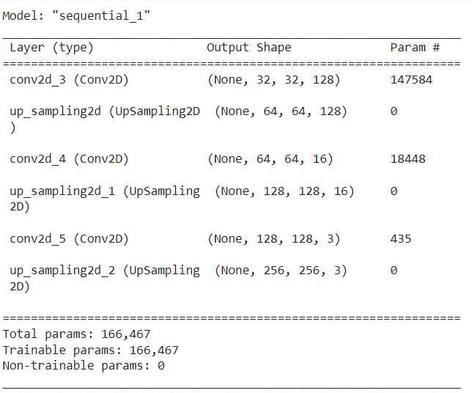
Algorithm Parameters
Split Data sets into 20% testing, 80% training sets using train_test_split and random_state
Encoder fed into Decoder
Convolutional and Max Pooling
Convolution and Up Sampling
Activation is Relu
Padding and Stride of 1
Loss is Mean Squared Error

Slide 8
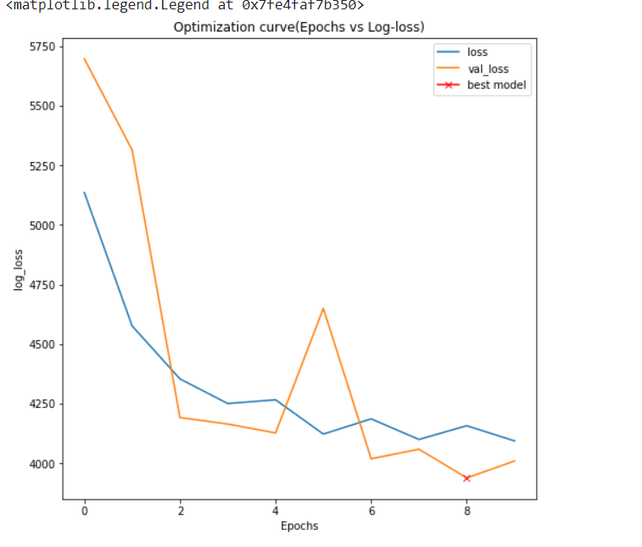
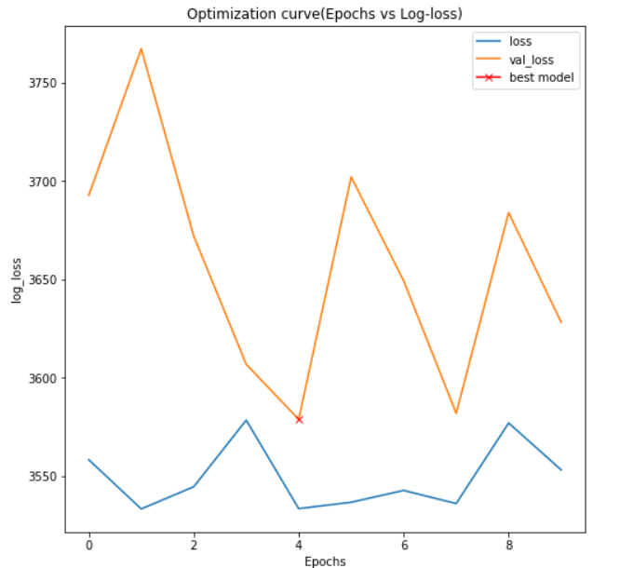
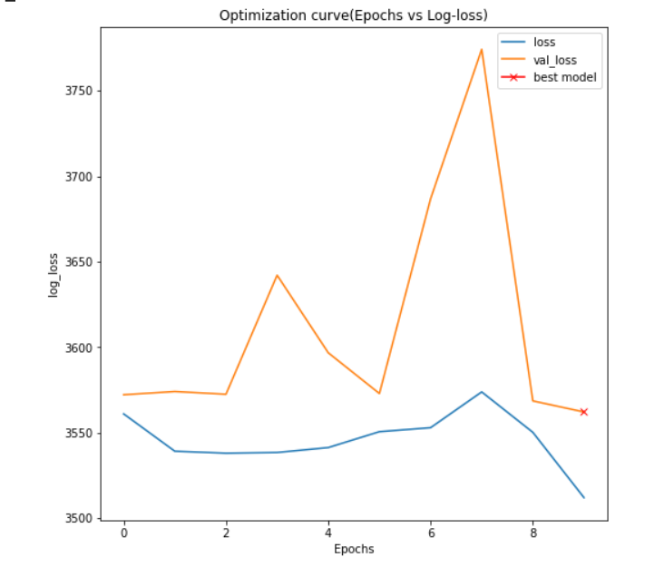
Algorithm Training
About 2 & ½ Minutes per epoch w/ 850 sets
Compare value loss, save best model after each epoch
Best model so far had batch size of 5, lower right
Other models tested, batch 1 upper right, 10 below

Slide 9
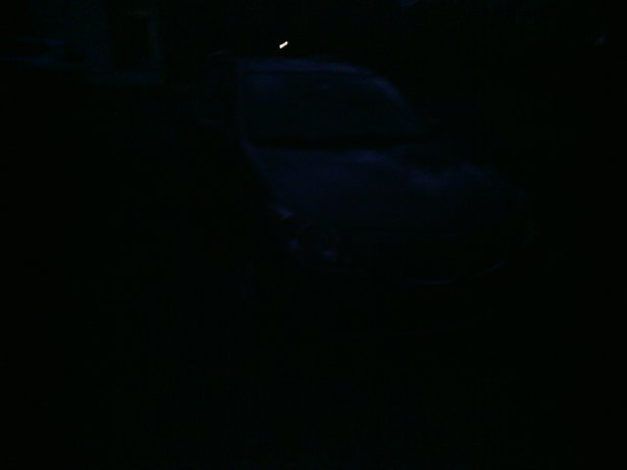
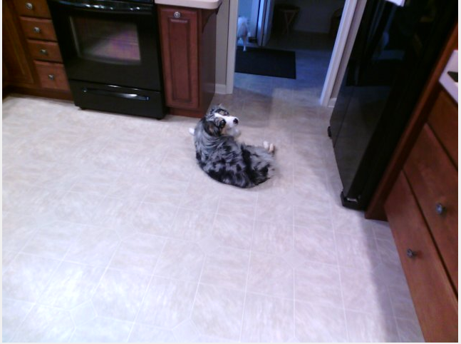
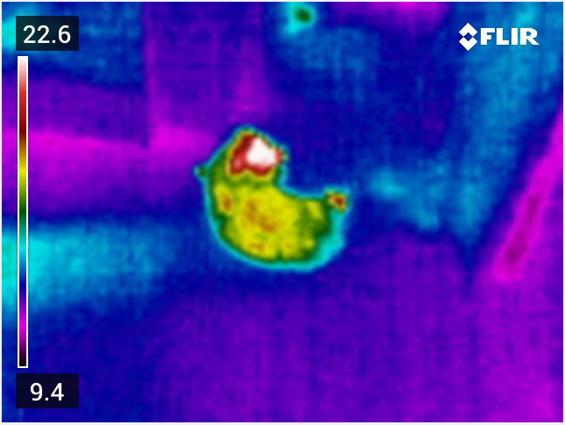
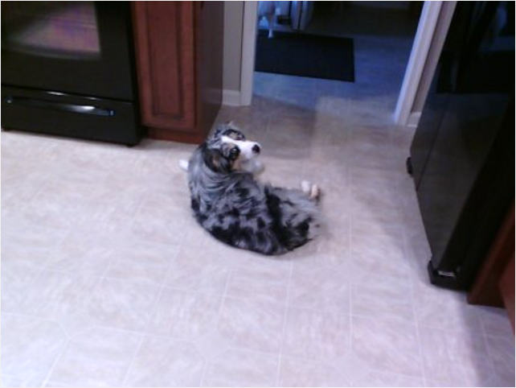
Initial Improvements
Removing image sets with low light RGB
Shrinking RGB images to match the Thermal
Varying Batch and Epoch sizes
Got from ~7000 to ~3600 Mean Squared Error Loss

Slide 10
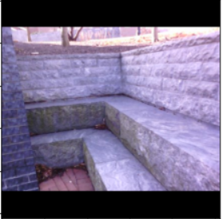
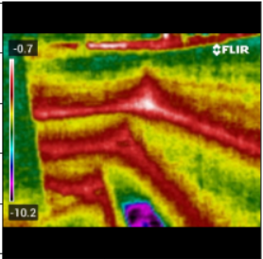

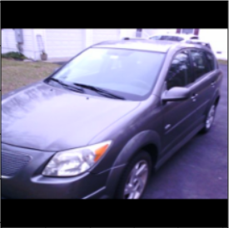
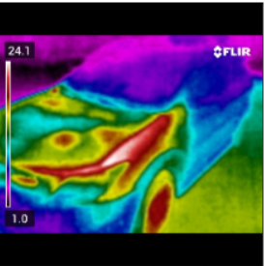

Preliminary Results
Input RGB Image
Input Thermal Image
Output RGB Image
Positives
Shape is discernible
Outlines are present, model is working
Notable difference when decreasing loss value, even at 100 loss difference
Negatives
Artifacts in the output
FLIR logo and heat spectrum
Color output is very grey
Model is averaging colors from training set

Slide 11
Timeline
4/6/22
Presentation
4/20/22
Try Different Decoder Model
5/4/22
Generate improved RGB outputs
Now
Final delivery
4/6/22 - 4/20/22
Further data collection, run with lots of epoch
4/20/22 - 5/4/22
Night time testing data collection
05/??/22
Final presentation
Notes:
old model -> convolution upsample. new model -> convolution transpose.

Slide 12
Thank you

